Slide 1


College Financing
MEFA’s Guide to

Slide 2
About MEFA
MEFA is a not-for-profit state authority that works to
make higher education more accessible and affordable through community education programs, college savings plans and low-cost financing options.
MEFA created the U.Fund® and the U.Plan® college savings plans and has provided affordable fixed interest rate college loans for 30 years.
MEFA has assisted hundreds of thousands of families in financing a college education.

Slide 3
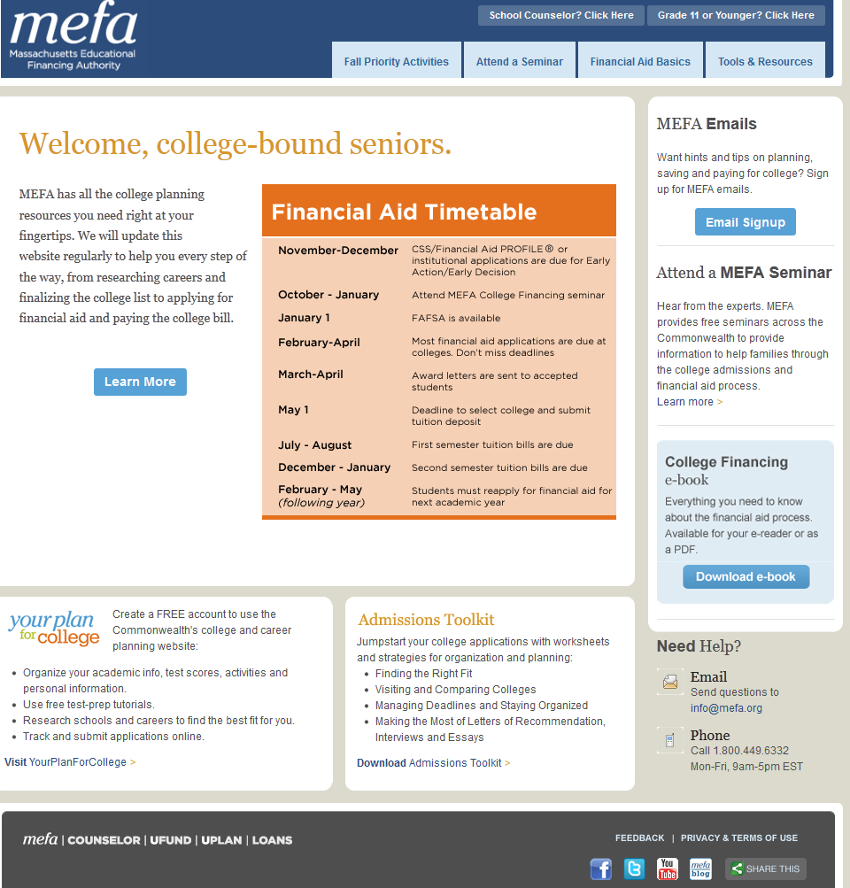
mefa.org/seniors
Step-by-step tips to walk you through the process
Tools & Resources
Email
Sign-up
e-Book
Videos/
Social Media
Ask an Expert

Slide 4
Seminar Topics
What is financial aid?
How do students apply?
How are financial aid decisions made?
What do financial aid awards look like?
How can families pay their share of college costs?
What free resources are available to help families?

Slide 5
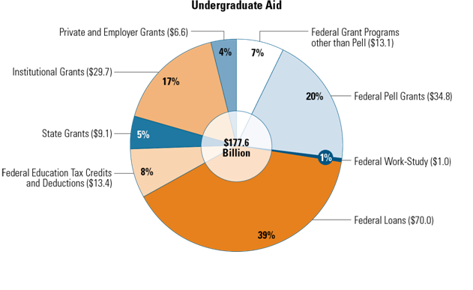
Overview of Financial Aid
Undergraduate Student Aid 2010-11 ($177.6 Billion)
Types of financial aid:
Grants and scholarships
Work-study
Loans
Source: The College Board, Trends in Student Aid 2011
*Source: The College Board, 2011 Trends in Student Aid

Slide 6
Sources of Financial Aid
Federal
  Grants, work-study, loans
Massachusetts
  Grants, scholarships, tuition waivers, loans
College/University (institutional aid)
  Grants, scholarships, loans
Outside Agencies
  Scholarships

Slide 7
Federal Student Loans
Student is the sole borrower
  No co-borrower or credit check
  No payments due while enrolled
Federal Direct Stafford Loan
  Two types:
    Subsidized – Fixed interest rate of 3.4% begins after graduation
    Unsubsidized – Fixed interest rate of 6.8% begins immediately
Federal Perkins Loan
  Fixed 5% interest rate begins after graduation
  Loan availability varies by college; not all colleges participate

Slide 8
Need-Based Aid
Awarded based on family’s financial eligibility
determined by standardized formula
Includes grants, loans and/or work-study
All federal and most state and institutional
aid is awarded based on financial eligibility

Slide 9
Merit-Based Aid
Awarded in recognition of student achievements (academic, artistic, athletic, etc.)
Applications are often compared against other students who apply
May or may not be renewable

Slide 10
Financial Aid Applications
Free Application for Federal Student Aid (FAFSA)
  Required by all colleges for federal and MA state aid
  Free form
  IRS Data Retrieval Tool
  Online application recommended (FAFSA.gov)
CSS/Financial Aid PROFILE®
  Required by some colleges for institutional aid
  Cost associated: $25 for first school, $16 for each additional
  Online application required
  Noncustodial Parent PROFILE required when applicable
College Financial Aid Application
  Required by some colleges
  Usually part of the admissions packet
  Applications must be completed every year

Slide 11

FAFSA Day Massachusetts
Free assistance in completing the FAFSA!
Sunday, January 27, 2013 at 1:00 pm
Over 25 locations across Massachusetts
Visit fafsaday.org
for additional dates and locations near you

Slide 12
What Happens After You Apply?
Colleges and state receive data electronically
You will receive (electronically or by mail):
  Student Aid Report (SAR)
  CSS/Financial Aid PROFILE® acknowledgement report
Review both for accuracy and keep for records
Colleges may request verification documents

Slide 13
Expected Family Contribution (EFC)
A calculation of how much a family has the ability to contribute toward student’s education for one year
Calculated using the same formula for every family, inputting data from financial aid applications
Family has the primary responsibility for contributing to the student’s education
Not necessarily what the family will pay over the course of the year
Visit mefa.org/seniors to use an EFC calculator

Slide 14
EFC Formulas
Federal and institutional formulas are different
  Federal formula for MA and federal aid
  Institutional formula for aid from some colleges
Includes income and asset protection allowances
Parent and student information treated differently
Does not include personal debt such as credit cards, auto loans or personal loans

Slide 15
Asset Impact – Family Size: 4
Parent income remains level, assets increase
 | Family A | Family B | Family C
Income | $60,000 | $60,000 | $60,000
Assets | $0 | $75,000 | $150,000
EFC | $3,930 | $5,117 | $8,348
Difference |  | $1,187 | $4,418
This example is an estimate only. Based on 2013-14 Federal Methodology (one child in college).

Slide 16
Income Impact – Family Size: 4
Parent assets remain level, income increases
 | Family A | Family B | Family C
Income | $60,000 | $100,000 | $150,000
Assets | $50,000 | $50,000 | $50,000
EFC | $4,260 | $12,832 | $27,147
Difference |  | $8,572 | $22,887
This example is an estimate only. Based on 2013-14 Federal Methodology (one child in college).

Slide 17
Financial Aid Formula
Cost of Attendance (COA)
– Expected Family Contribution (EFC)
= Financial Aid Eligibility
Colleges fill in Financial Aid Eligibility with financial aid from multiple sources

Slide 18
How the Formula Works
Cost of Attendance
Visit mefa.org/seniors to learn about net price calculators

Slide 19

Financial Aid Awarding
COA $30,000
– EFC $5,000
= Financial Eligibility $25,000
– Scholarships/Grants $15,000
– Student Loan $5,500
– Federal Work-Study $1,500
= Unmet Need $3,000
Unmet Need $3,000
Federal $1,500
Work-Study
Student $5,500
Loan
Grant $7,500
Scholarship $7,500
EFC $5,000
Cost of Attendance (COA)
This example is an estimate only.

Slide 20
Comparing Award Letters: Award Totals Vary
COA: $30,000 EFC: $5,000 Total Eligibility: $25,000
 | College E | College F | College G
Grants/Scholarships | $18,000 | $15,000 | $10,000
Student Loans | $5,500 | $5,500 | $5,500
Work-Study | $1,500 | $1,500 | $1,500
Total | $25,000 | $22,000 | $17,000
Unmet Need | $0 | $3,000 | $8,000
This example is an estimate only.
Visit mefa.org/seniors to access a College Cost Calculator

Slide 21
Comparing Award Letters: Award Totals Are Equal
COA: $30,000 EFC: $5,000 Total Eligibility: $25,000
 | College E | College F | College G
Grants/Scholarships | $15,000 | $5,000 | $0
Student Loans | $5,500 | $5,500 | $5,500
Parent Loan | $0 | $10,000 | $16,500
Work-Study | $1,500 | $1,500 | $0
Total | $22,000 | $22,000 | $22,000
Unmet Need | $3,000 | $3,000 | $3,000
This example is an estimate only.

Slide 22
Pathway To Paying The Balance Due
 |  | Favorite College
Balance Due |  | $20,000
Past Income | Student Savings | -$1,500
 | Parent Savings | -$4,000
Present Income | Student Contribution to Payment Plan | -$1,000
 | Parent Contribution to Payment Plan | -$3,500
Future Income | Education Loan | -$10,000
 |  | $0
EXAMPLE

Slide 23
Factors to Consider When Choosing a Loan
What is the interest rate and APR?
Is the interest rate fixed or variable?
  Fixed: stable, monthly payments not affected by economy
  Variable: changes based on market conditions; flexible budget required
Who is the primary borrower (student or parent)?
When does the loan repayment begin?
How much will the monthly payment be?
How many years will you be making payments?

Slide 24
After The Acceptance Regional Seminars
Over 25 Locations Across Massachusetts in late March/April
Follow-up to College Financing Seminar to provide key, timely information
Topics include:
  Understanding award letters and bills
  Loan options (parent and student)
  Payment Plans
  Working with the Financial Aid Office for special circumstances such as job loss or other reduction of income
Register for MEFA emails to receive location details

Slide 25

MEFA Services
mefa.org/seniors
MEFA semi-monthly email service for parents
E-books, on-line seminars, videos and calculators
Link to financial aid apps & scholarship search engine
“Ask a MEFA Expert”
Like us on Facebook! facebook.com/mefaMA
Follow us on Twitter! @mefatweets
Watch us on YouTube!

Slide 26
What You Can Do Now
Complete the seminar evaluation and sign up for MEFA emails
Visit fafsaday.org to find the closest FAFSA Day location, date and time, and mark it on your calendar
Bookmark mefa.org/seniors to access free college enrollment publications, webinars, the FAFSA and CSS/Financial Aid PROFILE®, calculators and more

Slide 27
Thank You
Questions or Comments?
Please take a moment to complete the seminar evaluation
Presenter: SHANNON VASCONCELOS
mefa.org/seniors

